Slide 1
Greedy Algorithm
Made By: Kashyap Shah (18DCE115)

Slide 2
What is Greedy Algorithm?
An algorithm is designed to achieve optimum solution for a given problem. In greedy algorithm approach, decisions are made from the given solution domain. As being greedy, the closest solution that seems to provide an optimum solution is chosen.
Greedy algorithms try to find a localized optimum solution, which may eventually lead to globally optimized solutions. However, generally greedy algorithms do not provide globally optimized solutions.

Slide 3
Advantages
Greedy is easy to be implemented. Just search the best choice from the current state that ‘reachable’ (has any paths or any connections).
In simple case, greedy often give you the best solution.

Slide 4
Drawbacks
In large and complex case, greedy doesn’t always give you the best solution, because it’s just search and take the best choice that you can reach from the current state.
It takes longer time than any other algorithms for big case of problem

Slide 5
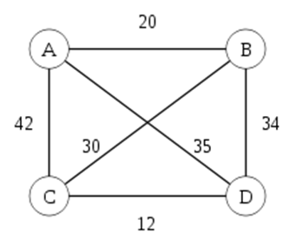
Sample Usage
For better explanation we use old simple problem:
Travelling Salesman Problem:

Slide 6
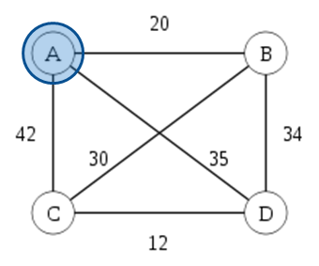
Sample Usage Problem
The Problem is how to travel from city A and visit all city on the map, then back to city A again.
The rules: you only visit each city once and you can’t pass through any traversed path.

Slide 7
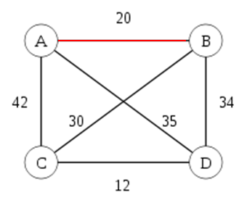

Solution
Find the shortest path from city A(start) to any other city.
Because the nearest city is B, so we go to B.
A
B

Slide 8
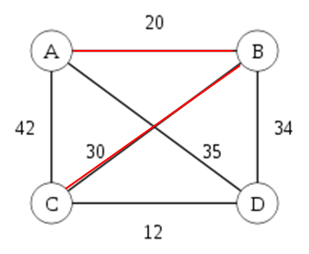
Solution Continued..
From B, we find any other city but A(because A has been visited) that has nearest path. So we choose C:
Keep tuning on…
A
B
C

Slide 9
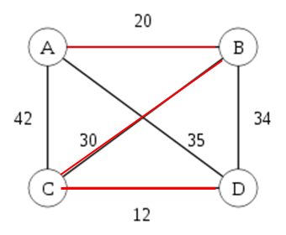
Solution Continued..
From C, we look to nearest city again, but don’t look for A and B, because both has been visited. So we choose D.
Keep tuning on…
A
B
C
D

Slide 10
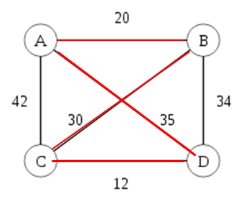
Solution Continued..
At this node(D), we can’t go to any city, because all neighbor of D has been visited. We go back to first city(A).
And that’s how to solve TSP problem.
A
B
C
D

Slide 11
Thank You

